Slide 1

Case Study
Erick Hernández

Slide 2
AGENDA
1) Notes on Case Study Rules
4) Model Development
2) Exploratory Data Analysis
2) Model Improvement
3) Feature Engineering
4) Conclusion

Slide 3

Case Study “Prediction of Applications at MoreJobs4Your”
Input data: Information on users and job descriptions.
Goal: Evaluate and predict if a person applied or not to a job position.
Rules …
Notes on Case Study
>
EDA
>
Feature Engineering
>
Model Dev.
>
Model Improvement
>
Conclusion

Slide 4
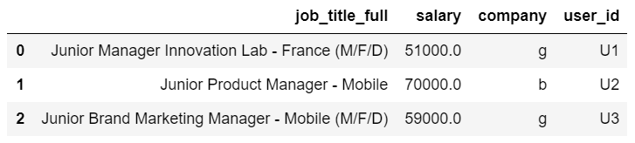
EDA
What can we learn from the dataset?
~70%
Missing
Job Description
User ID
Notes on Case Study
>
EDA
>
Feature Engineering
>
Model Dev.
>
Model Improvement
>
Conclusion

Slide 5
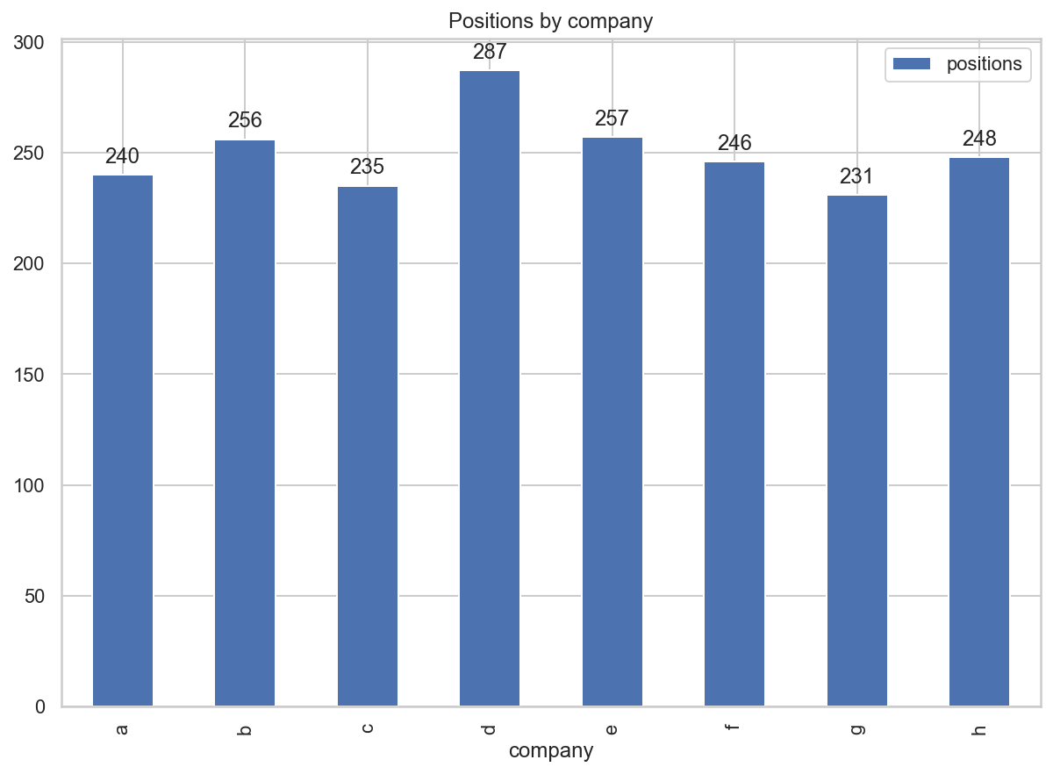
EDA
What can we learn from the dataset?
Notes on Case Study
>
EDA
>
Feature Engineering
>
Model Dev.
>
Model Improvement
>
Conclusion

Slide 6
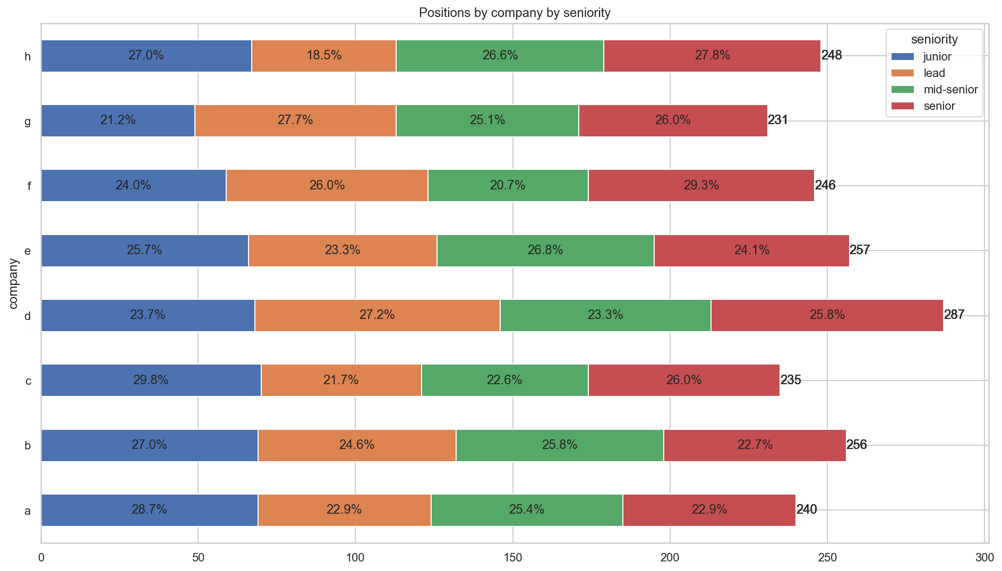
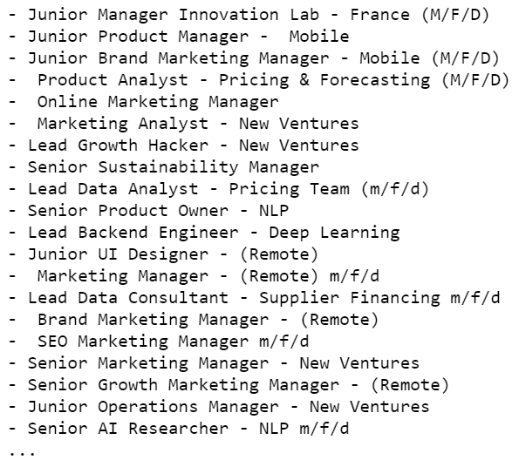
EDA
What can we learn from the dataset?
Notes on Case Study
>
EDA
>
Feature Engineering
>
Model Dev.
>
Model Improvement
>
Conclusion

Slide 7
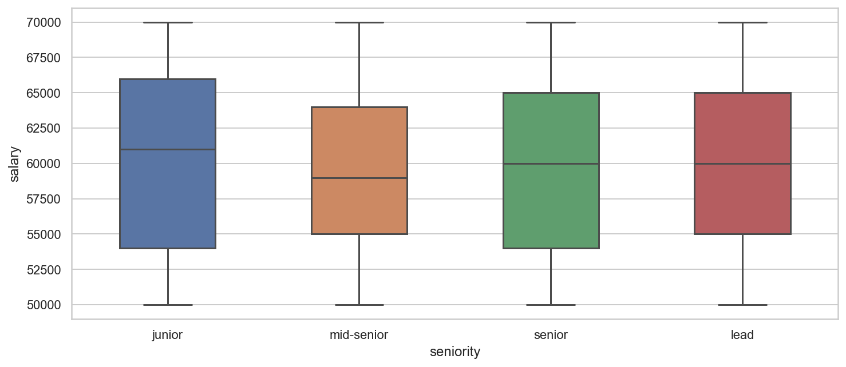
EDA
What can we learn from the dataset?
Notes on Case Study
>
EDA
>
Feature Engineering
>
Model Dev.
>
Model Improvement
>
Conclusion

Slide 8
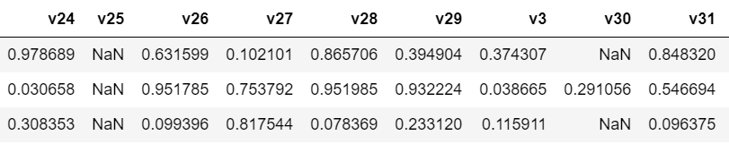
EDA
What can we learn from the dataset?
~70%
Missing
~70%
Missing
Notes on Case Study
>
EDA
>
Feature Engineering
>
Model Dev.
>
Model Improvement
>
Conclusion

Slide 9
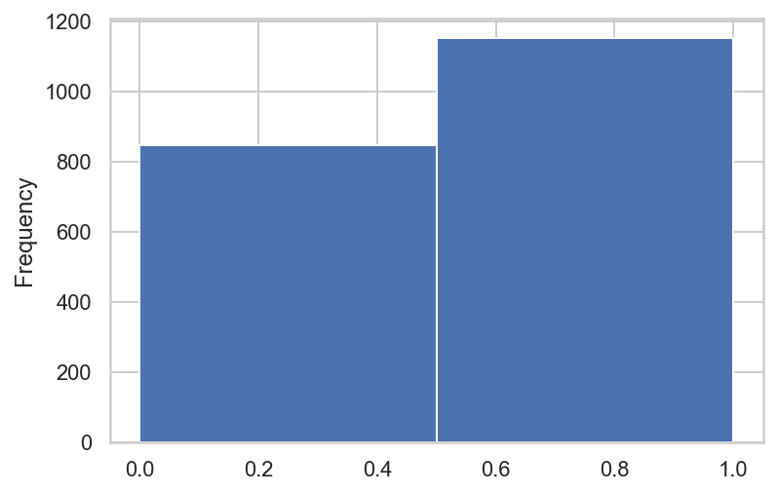
EDA
Notes on Case Study
>
EDA
>
Feature Engineering
>
Model Dev.
>
Model Improvement
>
Conclusion

Slide 10
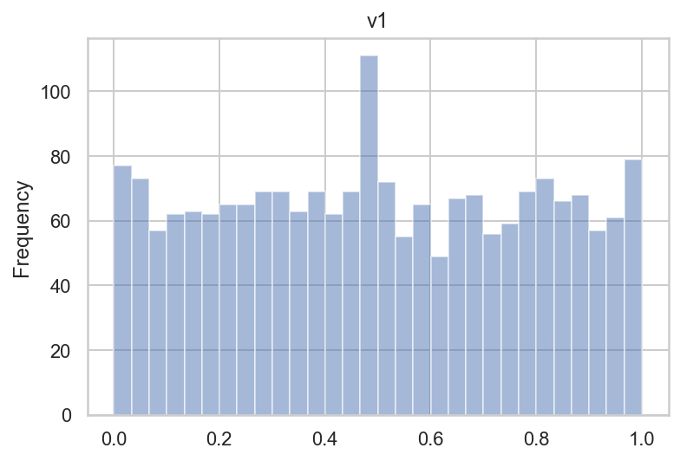
EDA
Notes on Case Study
>
EDA
>
Feature Engineering
>
Model Dev.
>
Model Improvement
>
Conclusion

Slide 11
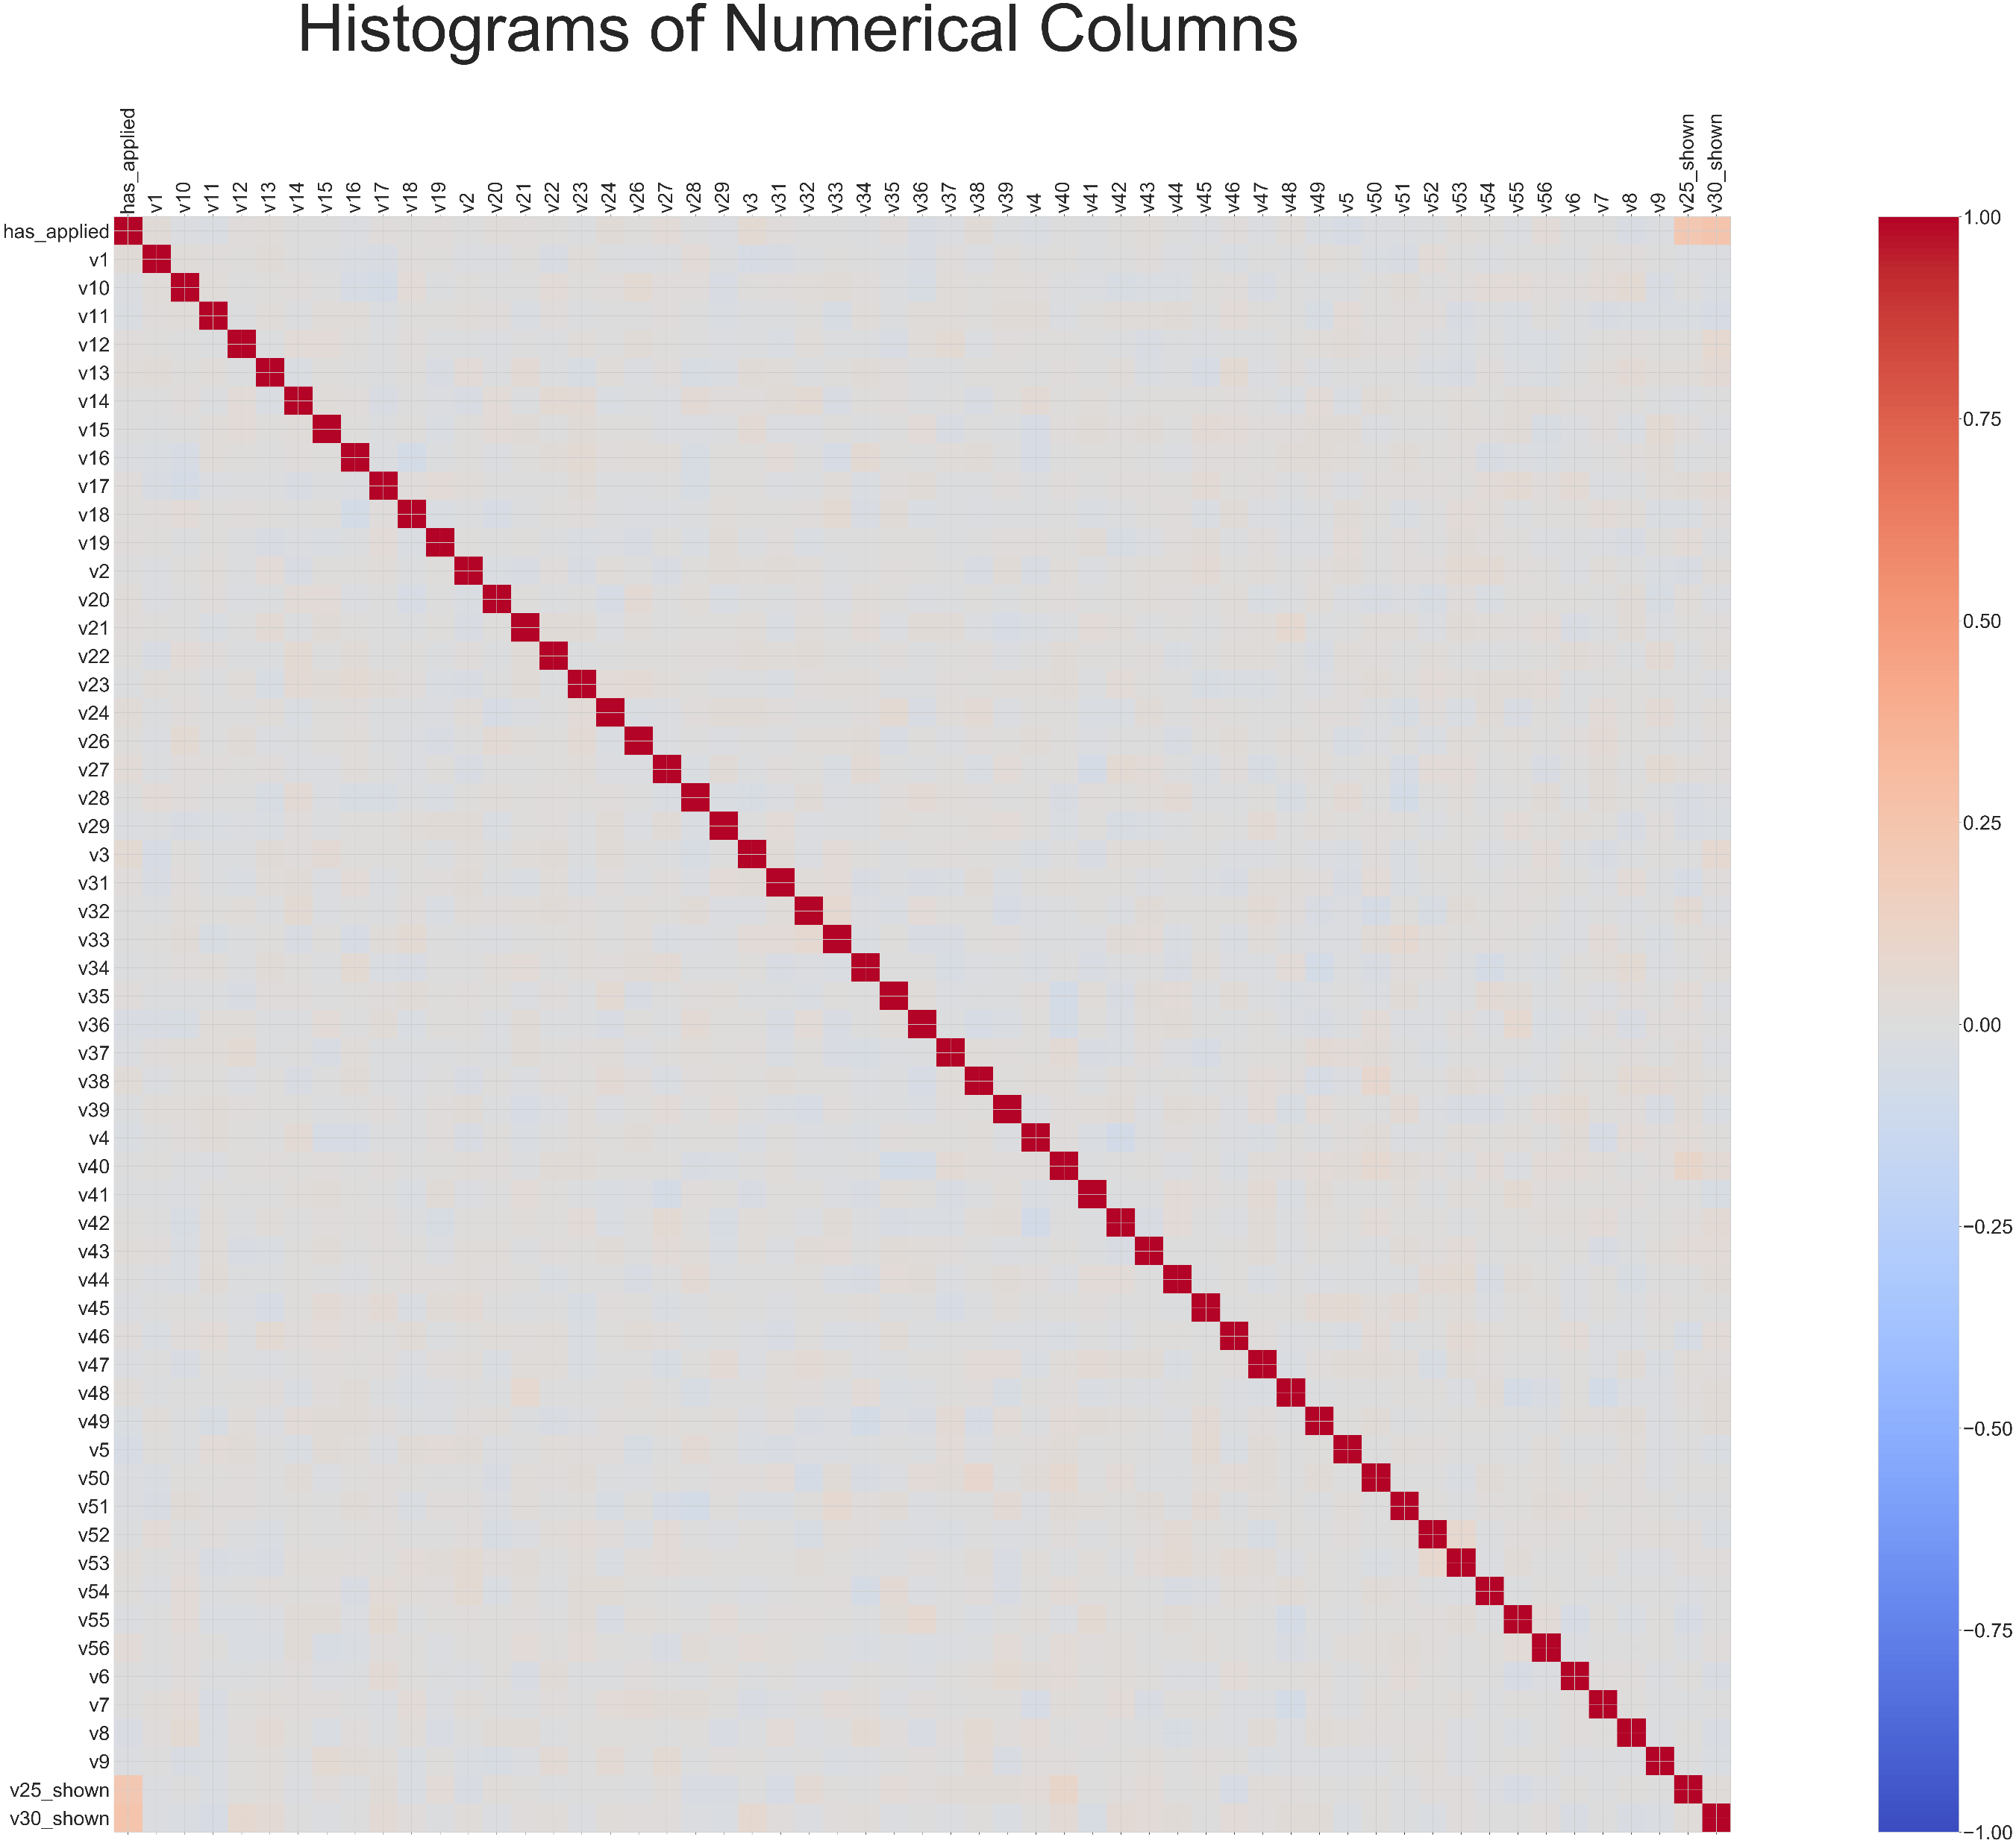
EDA
Notes on Case Study
>
EDA
>
Feature Engineering
>
Model Dev.
>
Model Improvement
>
Conclusion

Slide 12
Feature Engineering
'salary_shown’,
'company_b', 'company_c', 'company_d', 'company_e', 'company_f', 'company_g', 'company_h’,
'title_length’,
'seniority_lead', 'seniority_mid-senior', 'seniority_senior’,
'v1', 'v2', 'v3’, … , ‘v56’,
'v25_shown', 'v30_shown’,
0, 1, 2, 3, …, 99
Notes on Case Study
>
EDA
>
Feature Engineering
>
Model Dev.
>
Model Improvement
>
Conclusion

Slide 13
Model Development
SVM
AUC = 0.81
Notes on Case Study
>
EDA
>
Feature Engineering
>
Model Dev.
>
Model Improvement
>
Conclusion

Slide 14
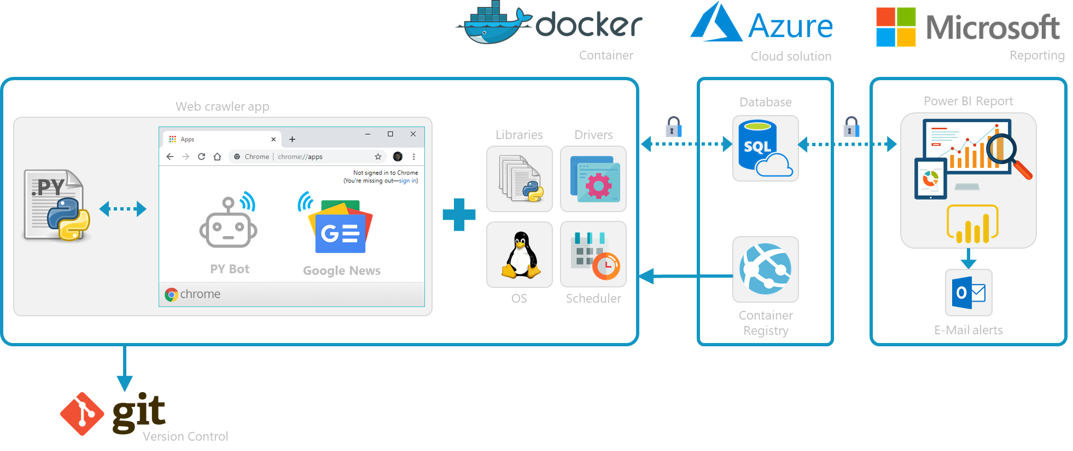

Technical design
Notes on Case Study
>
EDA
>
Feature Engineering
>
Model Dev.
>
Model Improvement
>
Conclusion

Slide 15
Model Improvement
GridSearch for:
- Extra Trees Classifier
- Random Forest Classifier
- AdaBoost Classifier
- Gradient Boosting Classifier
- SVM
- Logistic Regression
Notes on Case Study
>
EDA
>
Feature Engineering
>
Model Dev.
>
Model Improvement
>
Conclusion

Slide 16
Model Improvement
AdaBoost Classifier
AUC = 0.856
Notes on Case Study
>
EDA
>
Feature Engineering
>
Model Dev.
>
Model Improvement
>
Conclusion

Slide 17
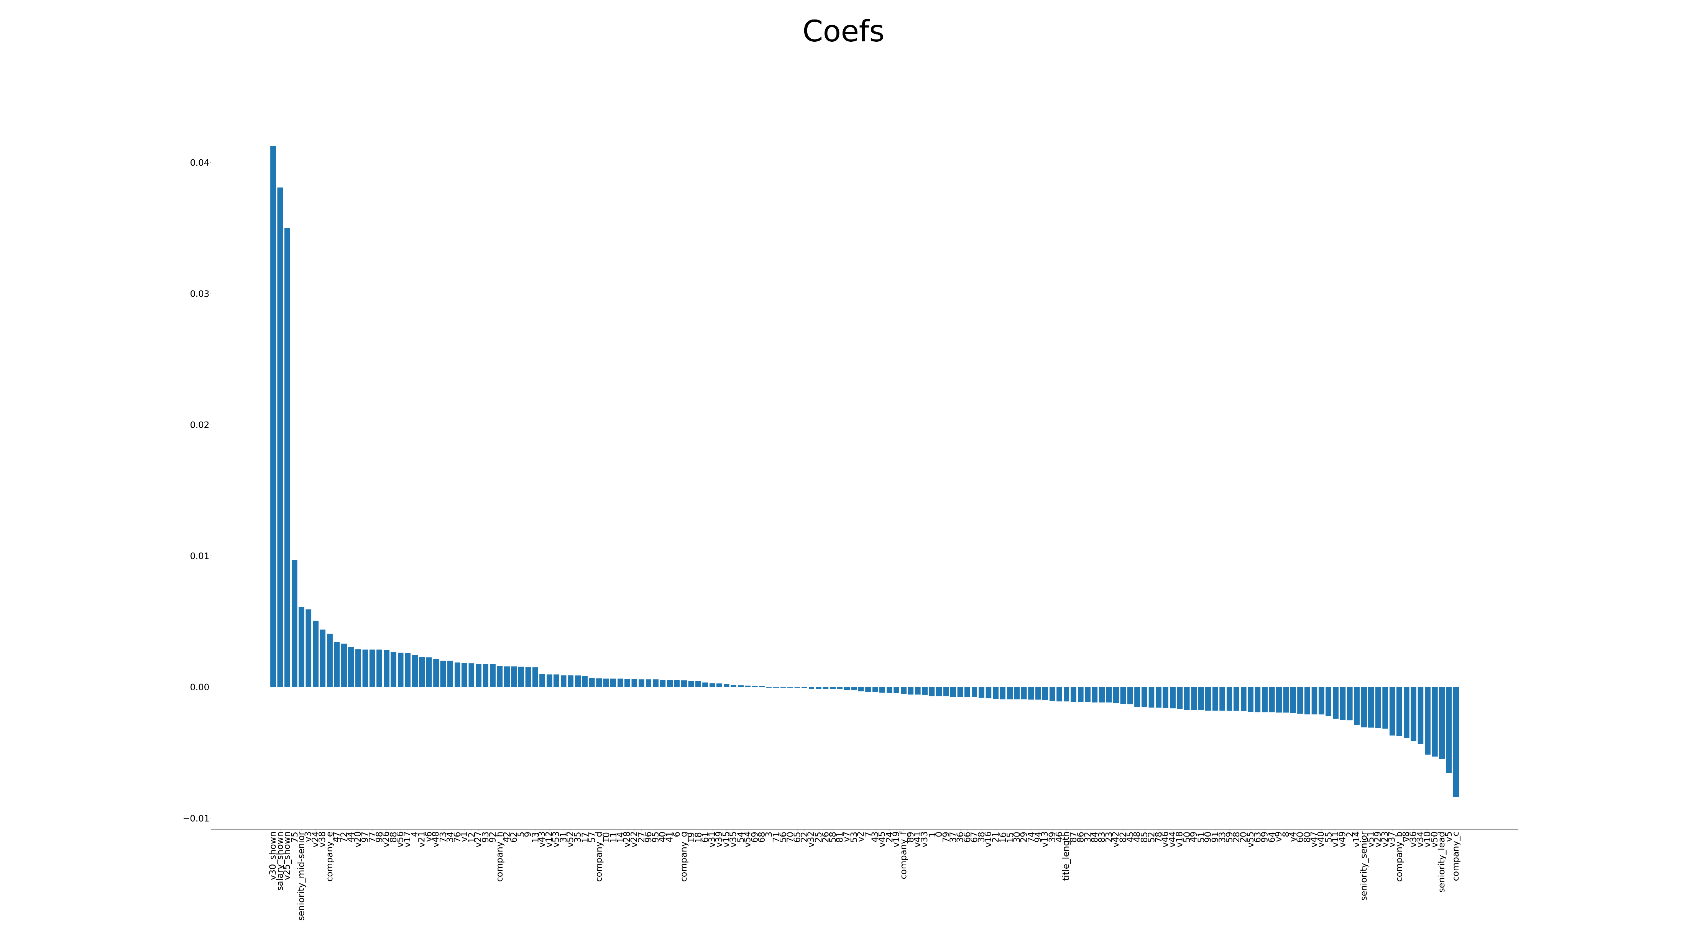
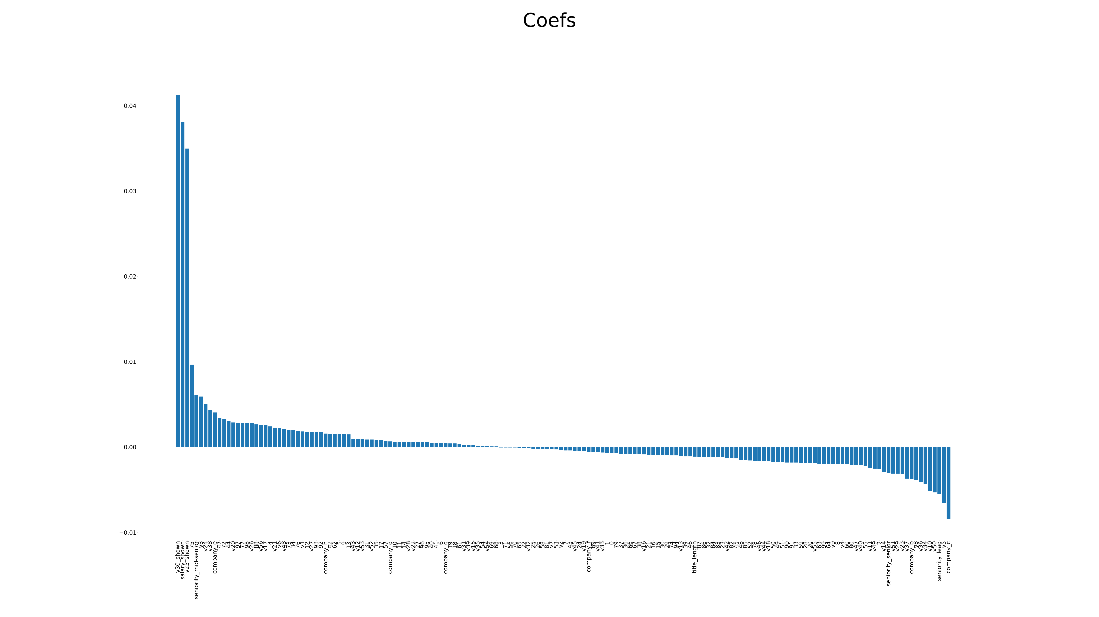
Coefficients
Notes on Case Study
>
EDA
>
Feature Engineering
>
Model Dev.
>
Model Improvement
>
Conclusion

Slide 18
Data is the new oil. It’s valuable, but if unrefined it cannot really be used. It has to be changed into gas, plastic, chemicals, etc. to create a valuable entity that drives profitable activity; so must data be broken down, analyzed for it to have value.
“
”
- Clive humby

